Slide 1

Project ERDOS
Towards End-to-End Compute Graph Optimization with Graph Neural Networks
Team:
Mohd Tabish Jamal
Nazar Iqbal
Rijin Shaji
Oishi Chatterjee
Raja Shekar Dubaguntla
Sathya Sudha Murugan
Presenter:
Rijin Shaji
Oishi Chatterjee
Mentor
Gabriel Campero Durand

Slide 2
Agenda
Recap
Implementation and Experimental Setup
Early Results
Next Steps

Slide 3
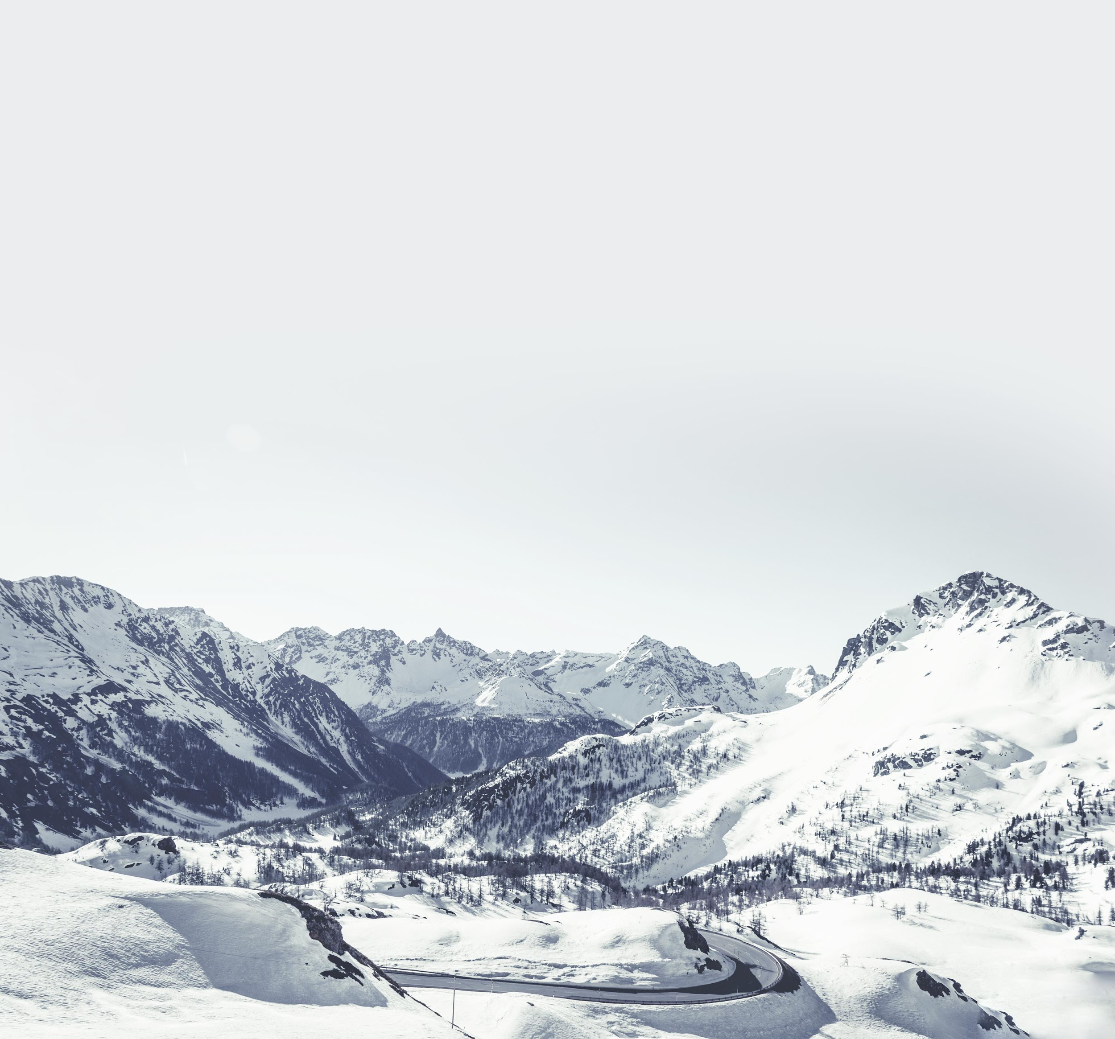
Recap

Slide 4
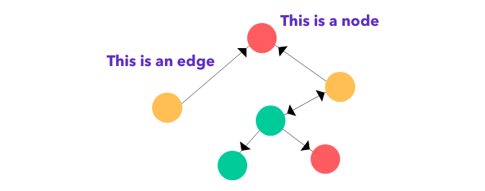
Motivation
Graph is a data structure that is defined by two components
Nodes/Vertex: Objects that are connected together
Edges: Connection between the two nodes
We are surrounded by programs and all programs are transformed into a Computational Graph to be executed.
https://medium.com/dair-ai/an-illustrated-guide-to-graph-neural-networks-d5564a551783

Slide 5
Motivation
Many applications use large Machine Learning / Neural Network models which has high computational requirements. To run the model optimally, the compiler places the nodes in ML accelerator(GPUs /TPUs)[3]. ML compilers map High-Level computational graph operations on these accelerators.[3]
Existing learning based approaches are sample inefficient, tackle a single optimization problem, and do not generalize to unseen graphs making them in feasible to be deployed in practice. ML compilers need to solve many optimization problems including Node-to-Device Placement, Operation Scheduling, and Operation Fusion. In this [3] paper it is proposed an end-to-end, transferable deep reinforcement learning method for computational graph optimization.
We are using Node Classification to determine which is the best Graph Neural network model, then use it in Reinforcement Learning[2]

Slide 6

Project Goals
RQ 1: To what extent does the performance of models(MoNet, GAT, GatedGCN, and GatedGCN-PE) improve by changing the Parameter Configuration on traditional Node Classification Datasets such as Pattern and Cluster.
The model which performs best in RQ1 would be considered further for RQ2.
https://dgtl.ventures/blog/what-is-the-goal-of-your-digital-transformation-project
RQ 2: To what extent does the performance of these models(MoNet, GAT, GatedGCN, and GatedGCN-PE) improve the Classification task on Dataset of Machine Learning Computation Graphs for Device Placement.
The model which comes out to be the best in RQ2, would be considered for future work with Deep Reinforcement Learning.
Long term Goal: To optimize the Databases with Deep Reinforcement Learning that uses Graph Neural Network.

Slide 7
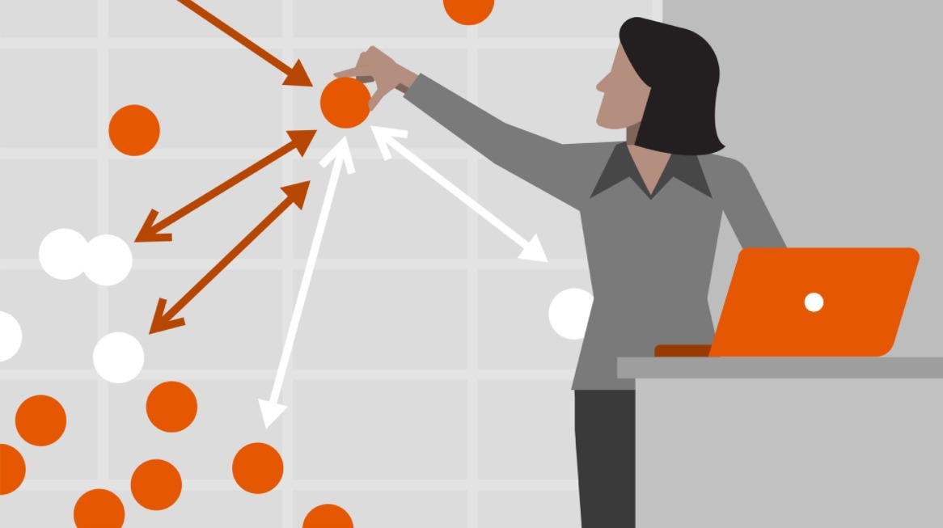
Prototype Design
To achieve RQ1, the models(MoNet, GAT, GatedGCN, and GatedGCN-PE) will be trained by using PATTERN and CLUSTER dataset
They will be tuned to improve the performance
To achieve RQ2, the Graph NN will be trained for Node-classification task by using the dataset containing ML Models for Device Placement
https://cdn.lynda.com/course/645048/645048-637356859282285031-16x9.jpg

Slide 8
Implementation and Experimental Setup

Slide 9
Models considered [2]
GAT
Gated GCN
MoNet

Slide 10
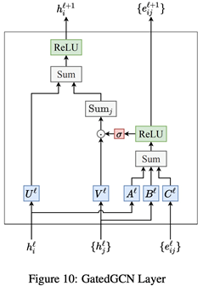
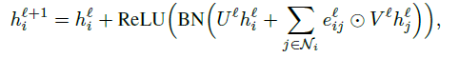

Gated GCN [2]
Different from other anisotropic GNNs, the GatedGCN architecture explicitly maintains edge features at each layer

Slide 11

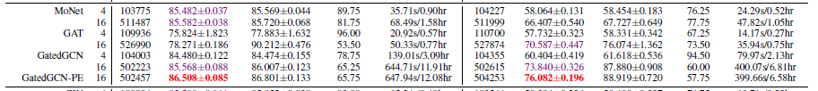
Why Gated GCN? [2]
[Dwivedi20] Models with the suffix -PE use Laplacian Eigenvectors as node positional encodings, with dimension 2 for PATTERN and 20 for CLUSTER
The best Node classification has been observed by [Dwivedi20] is in GatedGCN-PE* models
Datasets: PATTERN and CLUSTER
Notes:
Less accuracy when isomorphism exists

Slide 12
Why Gated GCN? [4]
Message-passing GCNs can better leverage the basic building blocks of deep learning such as batching, residual connections and normalization.
GCNs rely on sparse matrix computations, which are computationally and memory efficient.
Overall, anisotropic GCNs which leverage attention and gating mechanisms perform consistently across graph, node and edge-level tasks, improving over isotropic GCNs.
Graph positional encodings with Laplacian eigenvectors are an elegant approach to overcome the theoretical limitation of graph isomorphism and boost performance.

Slide 13
Datasets [2]
Artificial graphs generated from Stochastic Block Models (SBMs). SBM Data sets consider
Pattern – node level tasks of graph pattern recognition, aims at finding a fixed graph pattern embedded in larger graphs of variable sizes.
Cluster – aims at identifying community clusters in a semi-supervised setting
Dataset | #Graphs | #Nodes | Total #Nodes | Task
Pattern | 14k | 44-188 | 1,664,491 | Node Classification
Cluster | 12k | 41-190 | 1,406,436
PATTERN dataset has 10000 train/2000 validation/2000 test graphs
CLUSTER dataset has 10000 train/1000 validation/1000 test graphs.

Slide 14
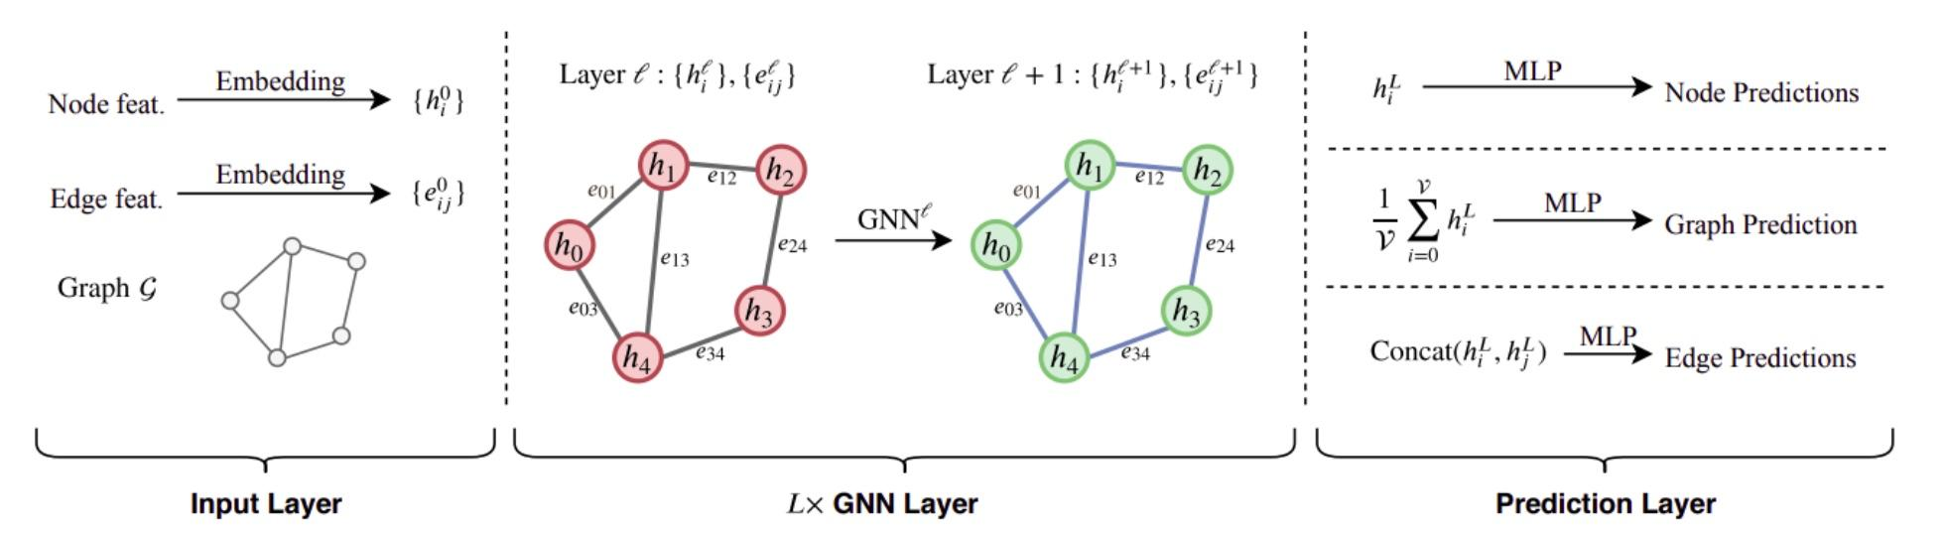
Training Pipeline [5]

Slide 15
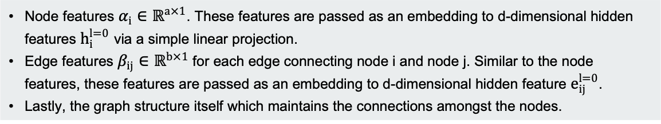
Training Pipeline [5]
Input Layer

Slide 16
Training Pipeline [5]
L x GNN Layer
This segment consists of the L layer neural network. This part of the training pipeline encapsulates the hidden layers of the GNN. The L layer deep network corresponds to L-hop neighborhood aggregation across the entire network. Since this is an iterative process, it can be visualized as a message-passing mechanism where each node receives updates from all its neighbors, which in turn receives updates from their neighbors.

Slide 17
Training Pipeline [5]
Prediction Layer
In the prediction layer, we utilize the GNN based node embeddings to predict the task-based outcome.
For Node Classification, we independently pass each node’s feature vector to a Multi-Layer Perceptron(MLP) and minimize the cross-entropy loss between obtained results and the ground truth.

Slide 18
Evaluation Metrics [2]
We are considering Accuracy as our evaluation metrics.
In this case it is the average node-level accuracy weighted with respect to the class sizes.

Slide 19
Early Results and Next Steps

Slide 20
Early Results
 | Parameters | Train Accuracy | Validation Accuracy | Test Accuracy
PATTERN | Layers=4,Hidden Dimensions=70,Edge feature=false,Pos encoding=true | 86.4 | 85.8 | 85.9
 | Layers=4,Hidden Dimensions=70,Edge feature=true,Pos encoding=true | 85.1 | 84.9 | 85.1
 | Layers=4,Hidden Dimensions=70,Edge feature=false,Pos encoding=false | 84.5 | 84.8 | 85
 | Layers=8,Hidden Dimensions=70,Edge feature=false,Pos encoding=true | 86.5 | 85.9 | 86
 | Layers=16,Hidden Dimensions=70,Edge feature=false,Pos encoding=true | 86.4 | 85.8 | 85.9
 | Layers=4,Hidden Dimensions=100,Edge feature=false,Pos encoding=true | 86.1 | 85.9 | 86.1
 | Layers=4,Hidden Dimensions=200,Edge feature=false,Pos encoding=true | 86.7 | 85.9 | 86.1
 | Layers=4,Hidden Dimensions=300,Edge feature=false,Pos encoding=true | 86.6 | 85.9 | 86

Slide 21
Early Results
 | Parameters | Train Accuracy | Validation Accuracy | Test Accuracy
CLUSTER | Layers=4,Hidden Dimensions=70,Edge feature=false,Pos encoding=true | 75.1 | 73.3 | 73.5
 | Layers=4,Hidden Dimensions=70,Edge feature=true,Pos encoding=true | 75.4 | 73.9 | 73.6
 | Layers=4,Hidden Dimensions=70,Edge feature=false,Pos encoding=false | 60.5 | 59.1 | 59.3
 | Layers=8,Hidden Dimensions=70,Edge feature=false,Pos encoding=true | 78.0 | 75 | 74.8
 | Layers=16,Hidden Dimensions=70,Edge feature=false,Pos encoding=true | 82.1 | 75.5 | 75.3
 | Layers=4,Hidden Dimensions=100,Edge feature=false,Pos encoding=true | 76.3 | 73.6 | 73.5
 | Layers=4,Hidden Dimensions=200,Edge feature=false,Pos encoding=true | 79.3 | 73.5 | 72.3
 | Layers=4,Hidden Dimensions=300,Edge feature=false,Pos encoding=true | 82.3 | 71.3 | 70.8

Slide 23
Next Steps
We will experiment with models Monet and GAT on same Pattern and Cluster dataset and get the best Model. This will answer our RQ-1.
And on that model, we train the dataset containing Machine Learning models for Node Classification, and that will solve our device placement task. This will answer our RQ-2.

Slide 24
References
Graph Representation Learning Book by Hamilton, William L.
Dwivedi, Vijay Prakash, Chaitanya K. Joshi, Thomas Laurent, Yoshua Bengio, and Xavier Bresson. "Benchmarking graph neural networks." arXiv preprint arXiv:2003.00982 (2020).
Zhou, Yanqi, Sudip Roy, Amirali Abdolrashidi, Daniel Wong, Peter Ma, Qiumin Xu, Hanxiao Liu et al. "Transferable graph optimizers for ml compilers." arXiv preprint arXiv:2010.12438 (2020).
https://wandb.ai/yashkotadia/gatedgcn-pattern/reports/Part-1-Introduction-to-Graph-Neural-Networks-With-GatedGCN--VmlldzoyMDg4MjA
https://wandb.ai/yashkotadia/benchmarking-gnns/reports/Part-2-Comparing-Message-Passing-Based-GNN-Architectures--VmlldzoyMTk4OTA

Slide 25
Thank you.

